Slide 1
HTML & CSS
Created by: Alice Lu
Special Thanks: Shuyu Chen

Slide 2
HTML
Hypertext Markup Language
Skeleton of the webpage
Defines overall structure of page
CSS
Cascading Style Sheets
Layout of webpage
Defines overall presentation of page

Slide 3
HTML vs CSS vs JS

Slide 4
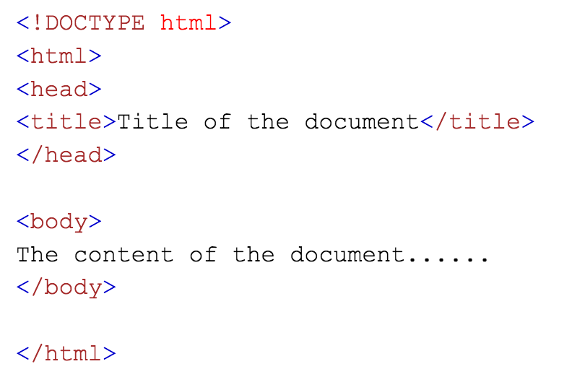
Basic Web Page Structure

Slide 5
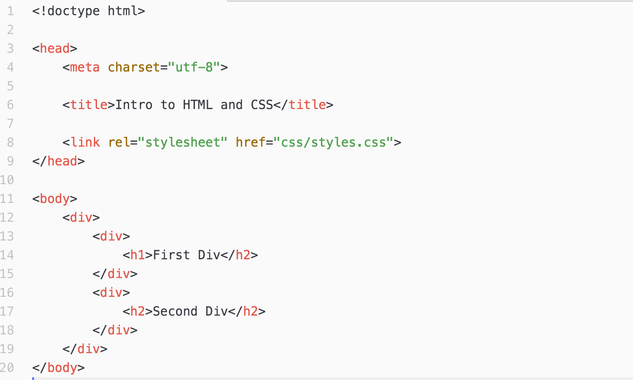
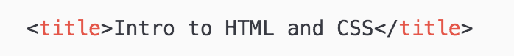
Tags
Each tag has a name, attribute, and attribute value
Tags can have single or multiple attribute name and value
Some tags don’t have closing tags
Tags can have encapsulation

Slide 6
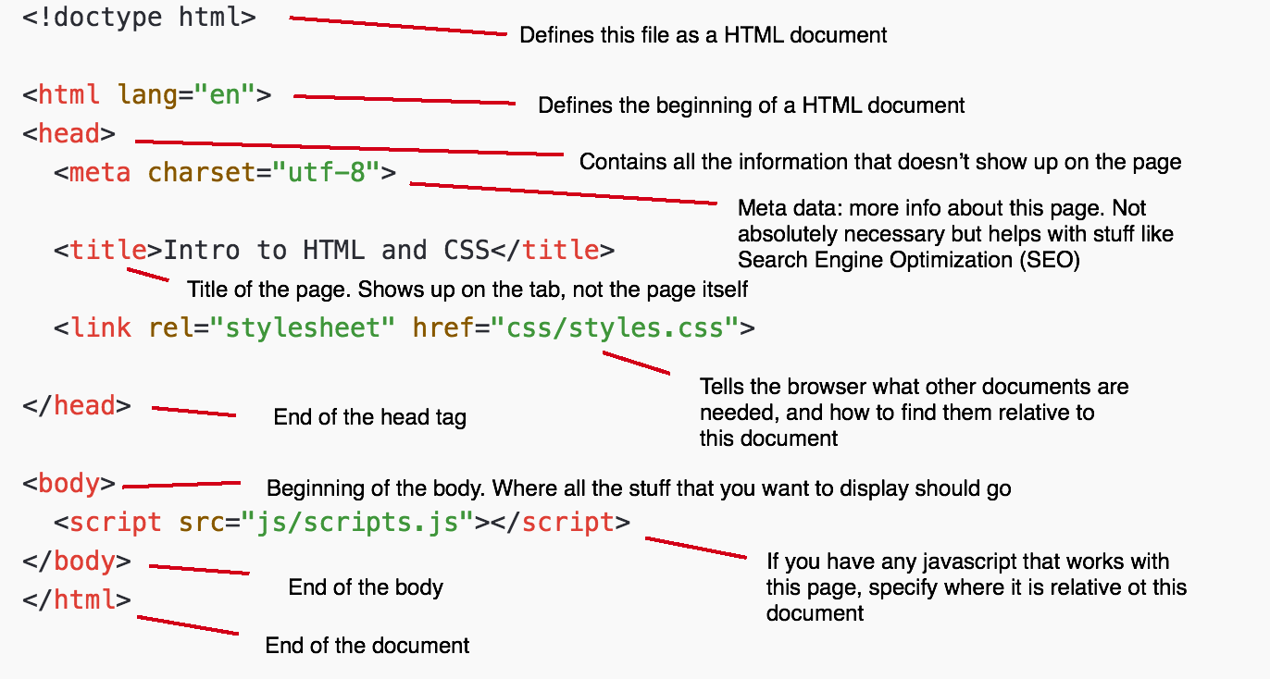
Structure of Typical HTML Doc

Slide 7
Let’s Start Coding!
Open Code Pen: https://codepen.io/
Optional: Sign up to save results

Slide 8
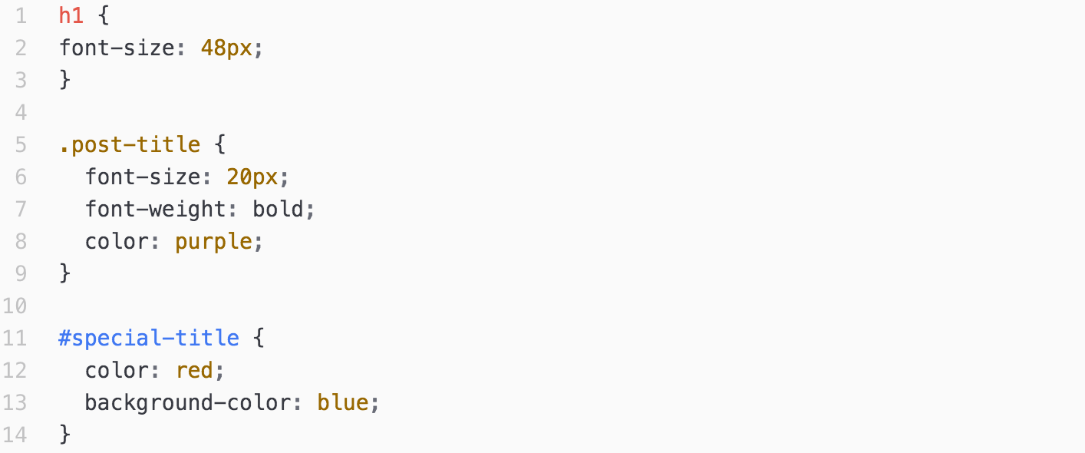
Structure of CSS

Slide 9
Typical Structure
Modify the default style of tags
Selectors can be a tag, class or id
Always end with a semicolon;

Slide 10
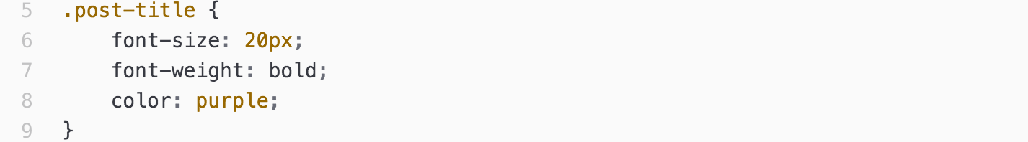
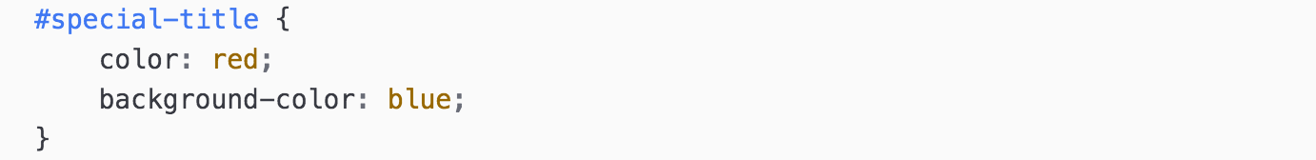
Example of Different Selectors

Slide 11
CONTINUE CODING!

Slide 12
THANK YOU
Follow us on Facebook and Instagram: @nyu_digitalartsclub

